Slide 1

DATABASE MANAGEMENT SYSTEM
Online Banking System

Slide 2

Dataset Overview
Secure Bank Corporation is a leading financial institution that specializes in providing a wide range of banking and financial services to individuals, businesses, and institutions. Established in 1975, Secure Bank has a long-standing tradition of excellence and commitment to its customers. Their retail banking services encompass savings and checking accounts, personal loans, and credit cards, accessible through both online and mobile platforms, as well as physical branches.

Slide 3

Business Rules
Every client has personal information, including name, address, and phone number.
Clients: Clients can maintain many accounts (savings, checking, etc.).
Accounts: Each consumer has an individual account.
There are several kinds of accounts, such as credit card, savings, investment, and checking.
Transactions: Transactions comprise amounts, dates, and kinds (deposit, withdrawal, and transfer) and are made on certain accounts.
Security and Compliance: To access any account, you must first authenticate.
Two-factor authentication and transaction verification for significant sums are part of security protocols.
Online and Mobile Banking: These systems allow cash transfers, bill payments, account management, and more.

Slide 4
Entity Relationship [ER]
Assumptions:
Each customer can have multiple accounts, and each account is associated with one customer.
Each account can have multiple loans, and each loan is associated with one account.
Each branch can have multiple cards associated with it.
Each branch can offer multiple loan types.

Slide 5
Enhanced Entity Relationships[EER]

Slide 6
Logical Design
Logical normalization includes addressing partial dependencies, ensuring that attributes are fully dependent on the primary key.
In the Enhanced Entity-Relationship (EER) model, relationships are logically represented, with foreign keys appropriately placed on the many side and directional arrows indicating the flow of relationships.
Foreign keys are strategically used to enforce referential integrity, maintaining consistency and coherence across related tables.

Slide 7
Functional Dependency

Slide 8
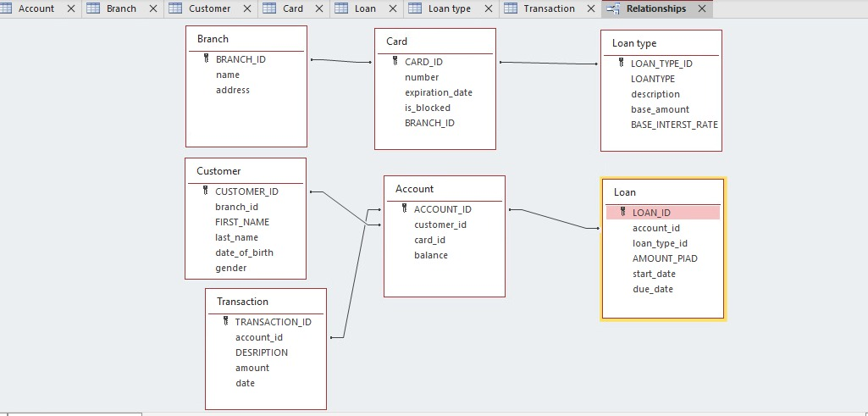
Physical database

Slide 9
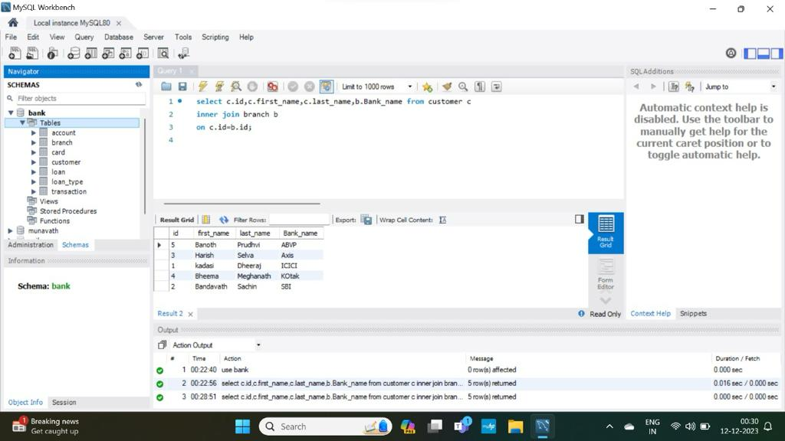
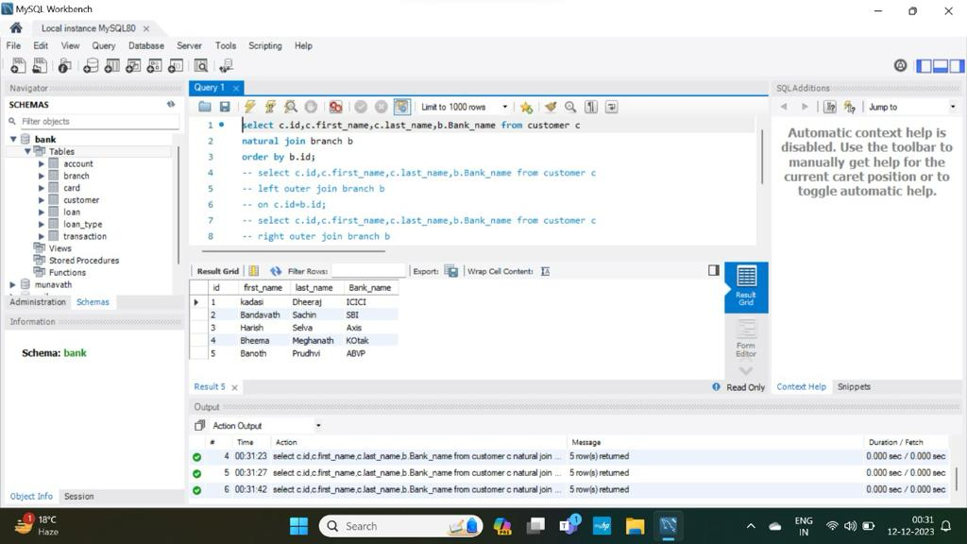
SQL Query
Inner join
Natural join

Slide 10
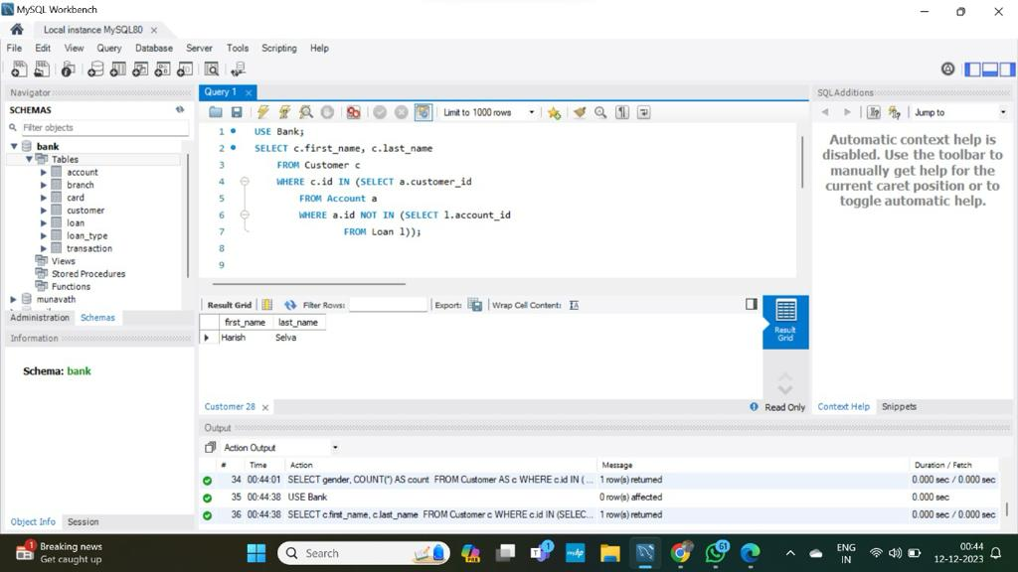
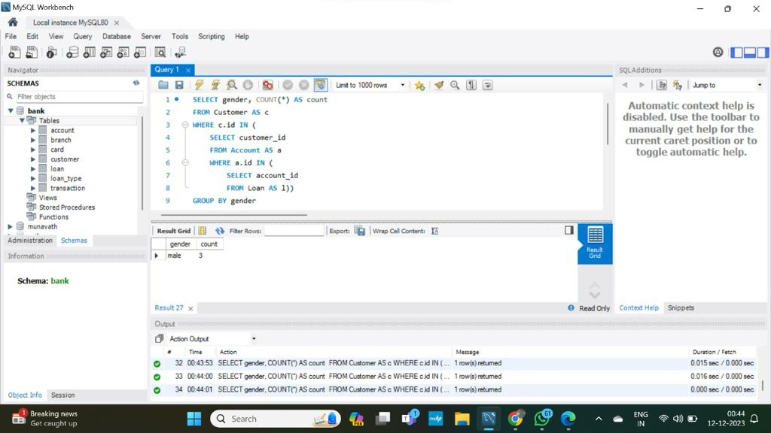
SQL Query
Customers who did’nt borrow the loan
Gender based loan comparison

Slide 11

Conclusion
This project is all about creating and using databases. It starts with drawing ER diagrams to plan the database, then By using Logical design we organizing the data in a smart way to make it reliable and fast. Finally, we use SQL , to find and analyze the data. This helps us manage information better and make smart decisions. The project shows how important good database design and the right tools to get data in various fields

Slide 12
Thank you

